Slide 1
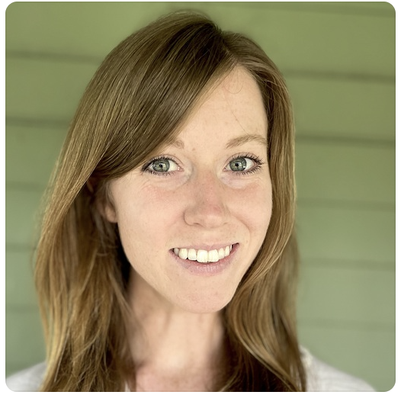

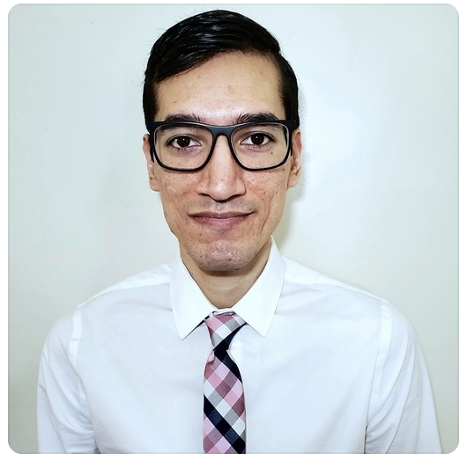
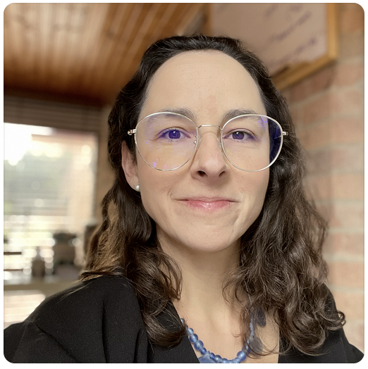

Identifying Age-Related Conditions
Host: Kaggle Stakeholder: InVitro Cell Research
Notes:
Juliana
Hello everyone. Our project is titled “Identifying Age-related conditions”, and is part of a Kaggle competition, held by Invitro Cell Research.
Our team is: Darby Brown, Bryan Burzon, Henry Caldera and myself, Juliana Gómez (NEXT SLIDE)

Slide 2

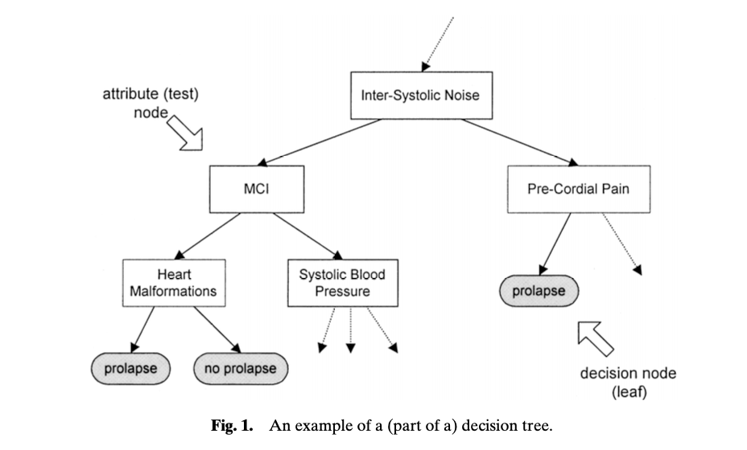
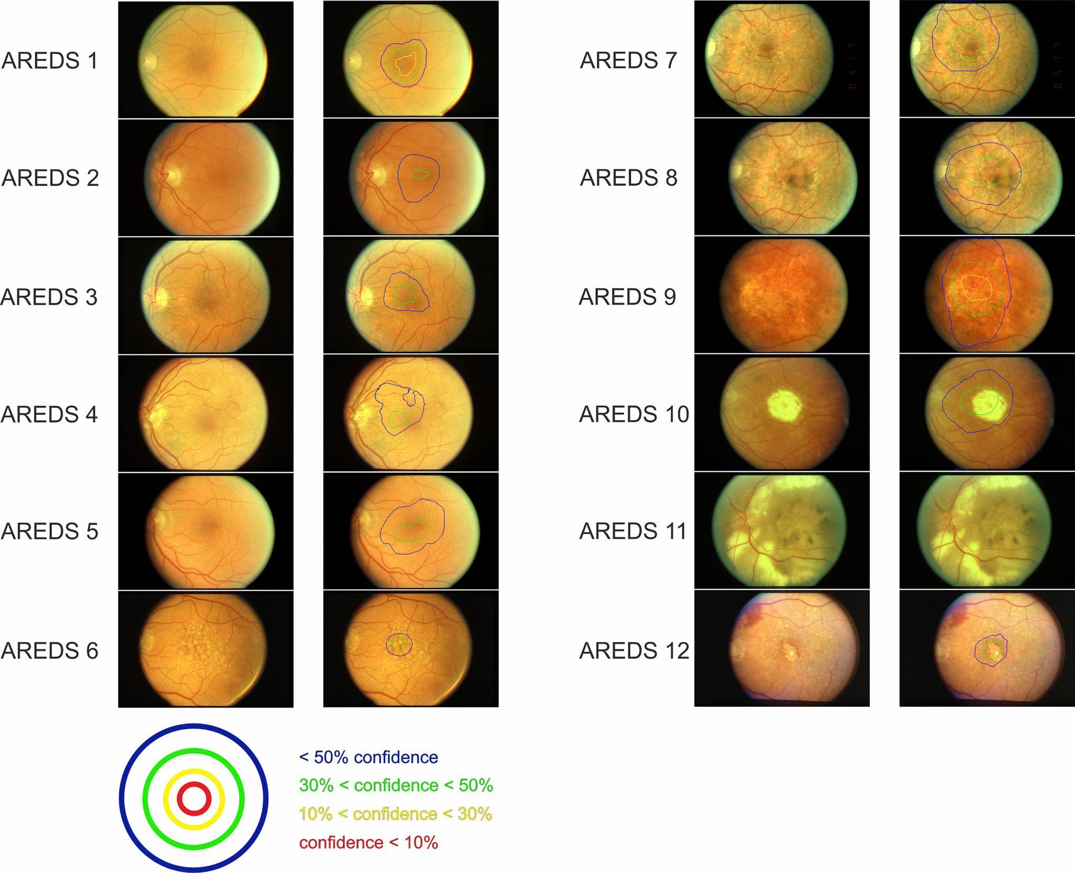
Can we predict the presence of any of three age related conditions?
Podgorelec et al. 2002
Grassman et al. 2018
Notes:
Juliana
We wanted to know whether we could predict the presence of any of three age related conditions, because
The current diagnosis approach is a long and intrusive process.
And we can shorten this process by using predictive modeling.
Previous work in medicine has mainly focused on two model families to examine this question: (CLICK) decision trees and (CLICK) neural networks.
Some applications of decision trees have been used to predict heart disease, while neural networks have been used to predict macular degeneration, both which are age-related diseases.
We therefore used decision trees and neural networks in our analyses, which Darby will explain in more detail. (NEXT SLIDE)
Explain what has been done before in this space:
Decision Trees:
Porgorelec et al. 2002. Decision Trees: An Overview and Their Use in Medicine
Mythili et. al. 2013. A Heart Disease Prediction Model using SVM-Decision Trees-Logistic Regression (SDL): “Most of the papers have implemented techniques such as SVM, neural networks, regression, decision trees, naïve Bayesian classifiers, etc. on multiple databases of patients from around the world.”
Alageel et al. 2023. Using Machine Learning Algorithm as a Method for Improving Stroke Prediction.
Deep Neural Networks: Grassman et al. 2018 A Deep Learning Algorithm for Prediction of Age-Related Eye Disease Study Severity Scale for Age-Related Macular Degeneration from Color Fundus Photography
Describe your overall plan to approach your question:
Provide a summary of your results.

Slide 3
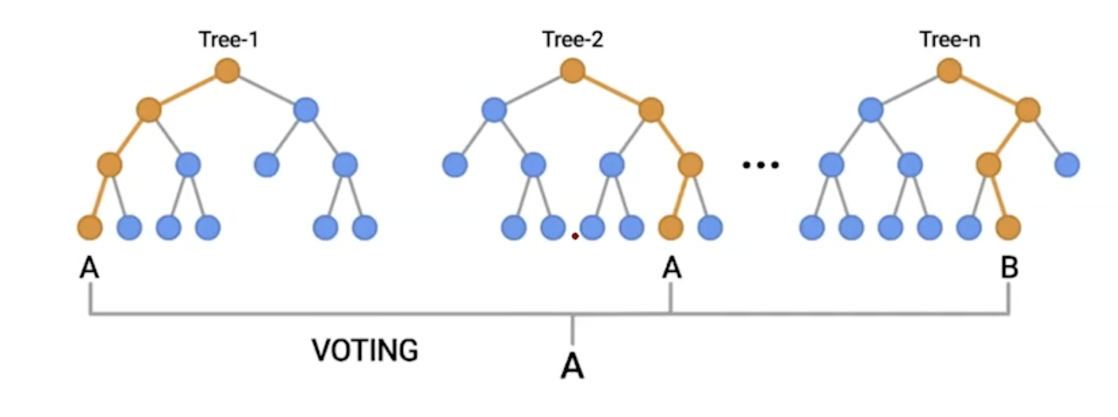
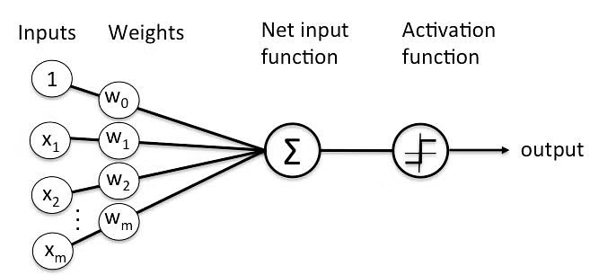
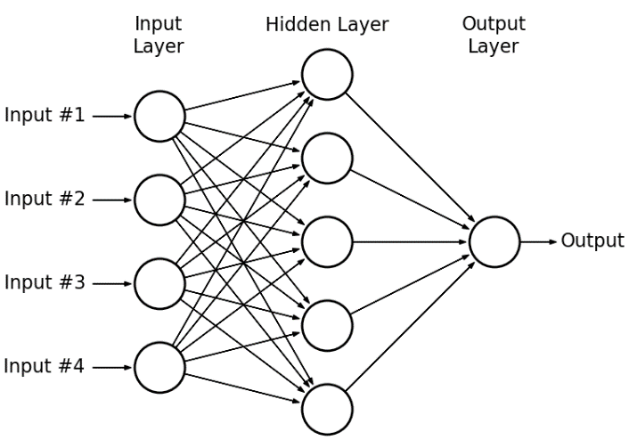
Overview of Modeling Approach
Baseline
Decision Trees
Neural Networks
More complexity
y_pred = 0
Notes:
Darby
When deciding our modeling approach, we started with our baseline. Due to the nature of the problem (diagnosing disease), most of the observations are class 0. We chose a baseline of simply predicting y = 0 which yields roughly 81% accuracy already. For the model choices, we opted for models that perform well for binary classification and models that were previously used in literature. Breaking it down into 2 categories, we focused on some decision trees and neural network architectures. With decision trees, we tried Random Forest and added complexity by trying XGBoost. For Neural networks, we started at the most basic with a simple perceptron, and progressed to logistic regression, then to multiplayer preceptron which is a type of feed-forward neural network.
1- Motivation:
Describe your overall plan to approach your question:
Baseline: Always predict 0 (none of the age related conditions)
Decision trees:
Random forest
XGBoost
Neural Networks
Perceptron
Multilayer perceptron
More complexity
More layers
Hypertuning
Provide a summary of your results.

Slide 4

Can we predict the presence of any of three age related conditions?
Baseline
Decision Trees
Neural Networks
More complexity
 |  | Baseline | RF | XGBoost | Log reg | Perceptron | Multilayer
auprc | Train Validation Test | 0.20 | 1.00 0.97 0.83 | 1.00 0.87 0.86 | 0.86 0.73 0.55 | NA | 0.99 0.84 0.84
loss | Train Validation Test | — | 0.00 0.09 0.00 | 1.84 1.62 1.47 | 0.42 0.49 0.86 | 112 misclassified NA NA | 0.03 0.37 0.19
Notes:
Bryan
1- Motivation: Provide a summary of your results.
We took it upon ourselves to each take a model and after many trials and tribulations here are the results based on the log loss and auprc score for each of the training, validation and test set that we utilized in our model.
One noticeable thing about this result is our perceptron model as This particular model did not converge which we will talk about later.
Starting from left to right we can see that for the most part our most basic models on the left were not as performant as compared to the more complex models such as the multilayer perceptron.
As a caveat and will be a theme throughout this presentation is the idea of how to deal with an imbalance dataset. As a spoiler, we dealt with this in two fronts both from the data and also the model.
When taking into account both the AUPRC and Log Loss We can see that multilayer perceptron performed
Comparatively better relative to the other models that were overfitted aka the decision tree or had relatively high Log loss.
I will turn it over to Henry to talk more about our data.

Slide 5
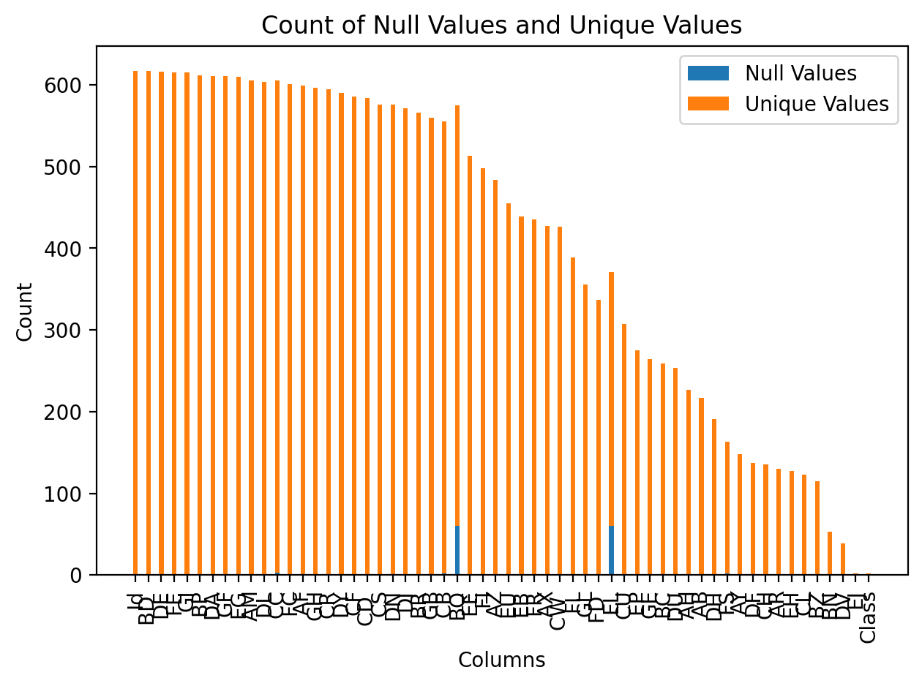
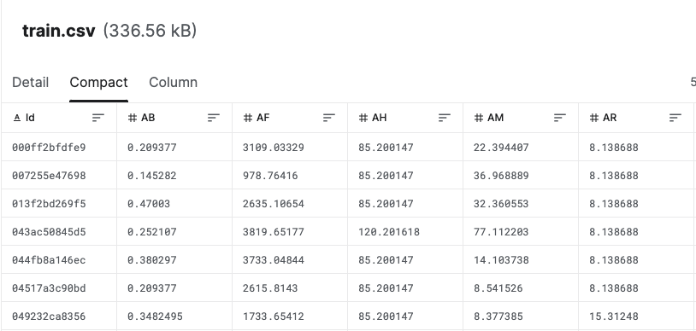
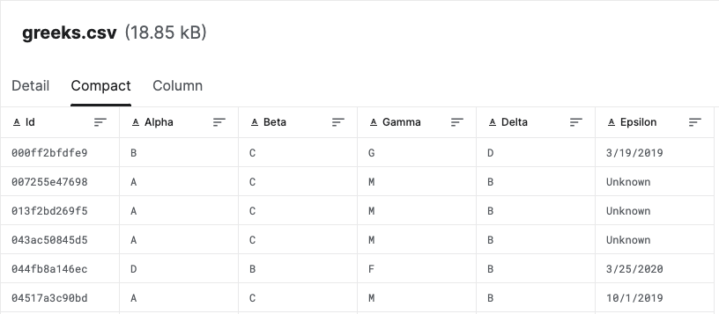
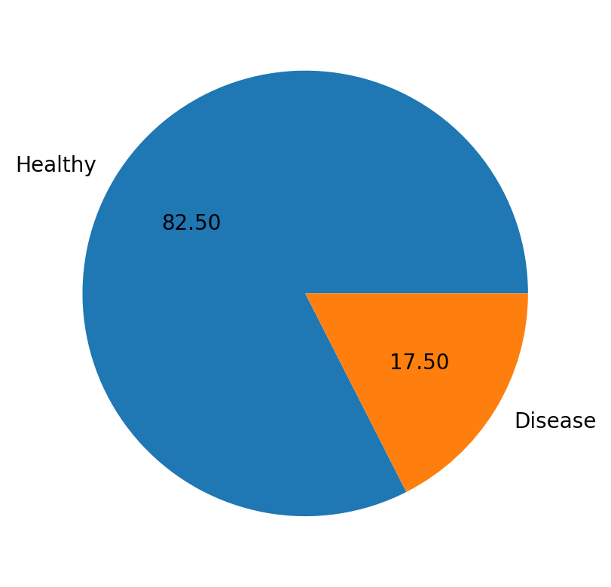
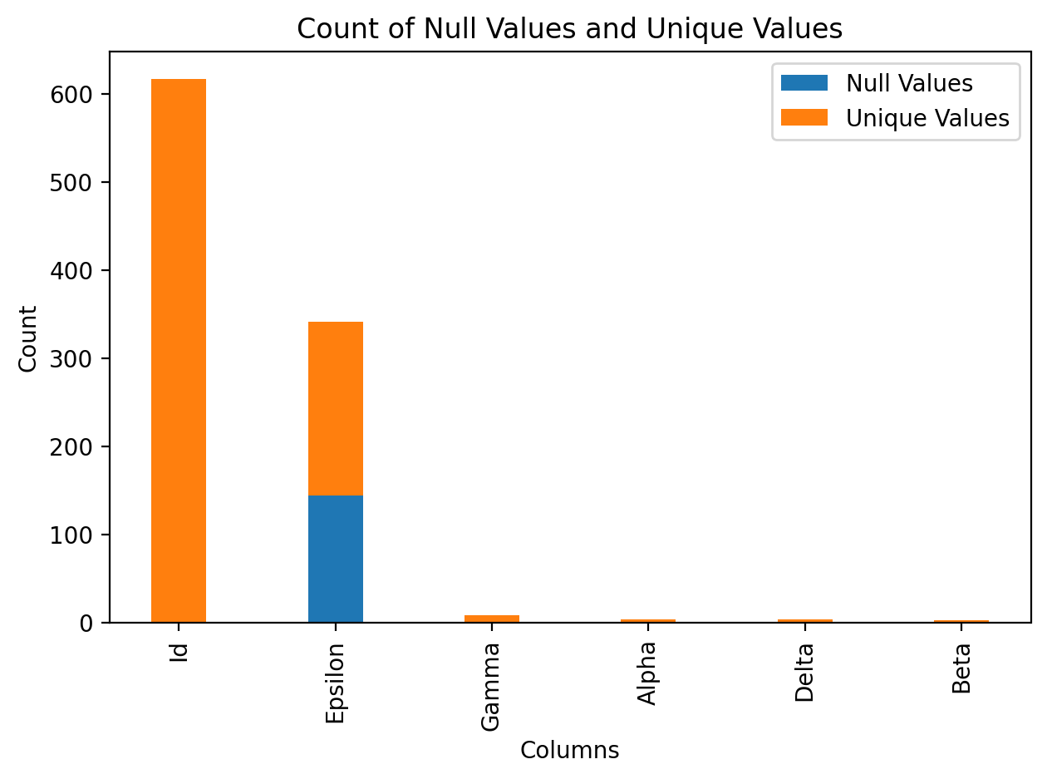
Data
Notes:
Henry
(15%) Data: Describe in detail the data that you are using, including the source(s) of the data and relevant statistics.
Source: InVitro Cell Research
Full dataset shape is (617, 61):
617 rows
60 features:
56 health characteristics
3 experimental conditions
Date when data was collected
Labels: A binary target:
1:one of the three conditions
0: indicates they have not.
EDA:
Unbalanced data set
Missing data

Slide 6
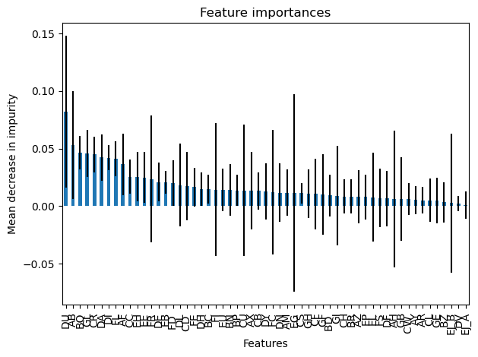
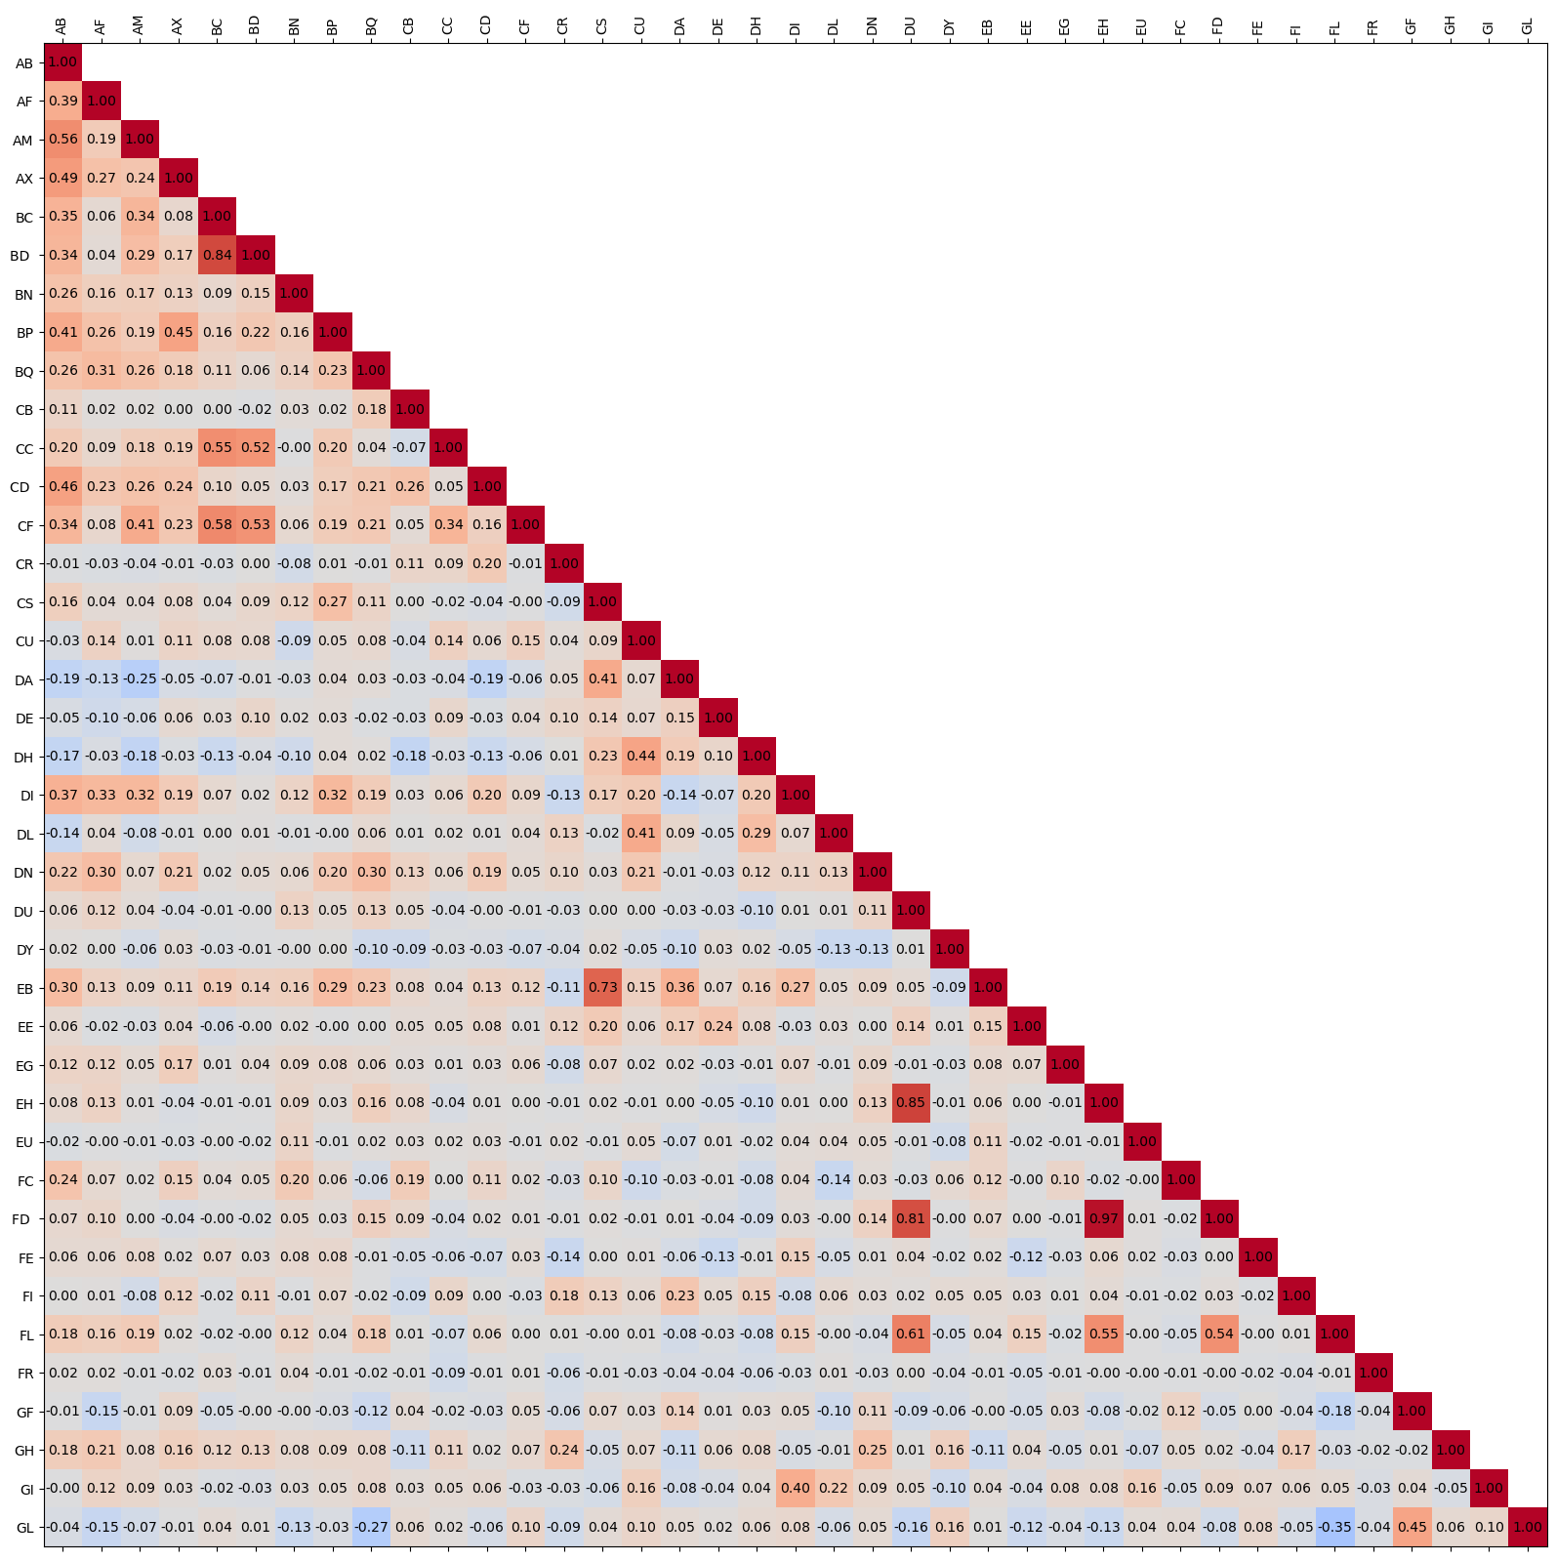
Approach
Baseline
Decision Trees
Neural Networks
More complexity
Feature Reduction
Random Forest
XGBoost
Don’t include
Notes:
Juliana
Thank you Henry. We used decision trees in three ways (CLICK)
First, we used them for feature selection. To do this, we ran a RandomForest Classifier, and selected the top 39 features with greatest mean decrease in impurity. (CLICK)
We chose this number because a Principal Components Analysis showed that 39 of the 56 features contributed to 95% of the variance.
However, we noticed that some of these features we highly correlated (CLICK) so we excluded them from our feature selection.
We used the final subset of features as input for our Neural Network Models. (NEXT SLIDE)

Slide 7
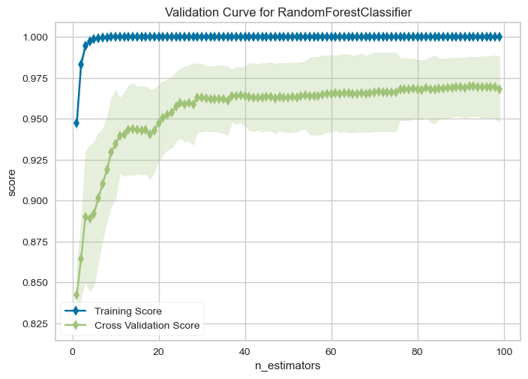
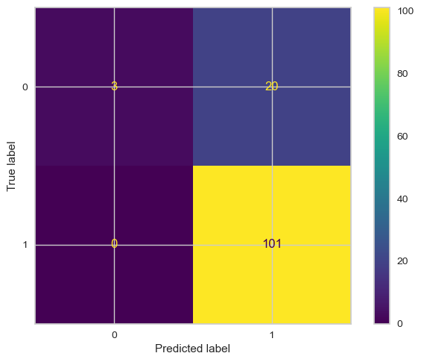
Approach
Baseline
Decision Trees
Neural Networks
More complexity
Feature Reduction
Random Forest
XGBoost
Notes:
Juliana
Second, we used PCA as input for our Random Forest with a k-fold cross-validation. Our results were not great, due to large overfitting (CLICK) and large amounts of false positives (CLICK) (probably due to how we handled class imbalance).
Now Bryan is going to tell you about the third way in which we used decision trees. (NEXT SLIDE)
(15%) Approach: Describe in detail the models (baseline + improvement over baseline) that you use in your approach.
Random Forest:
1. Weighted RandomForest Classifier, with a 10-fold cross validation. Metrics: auprc and balanced log-loss. Best model: RandomForestClassifier(class_weight={0: 2.9, 1: 0.6041666666666666}, criterion='entropy', max_depth=9, n_estimators=300, oob_score=True, random_state=42)
||auprc|log_loss|
|---|---|---|
|Train|1.00|0.00|
|Validation|0.97|0.09|
|Test|0.83|0.00|
2. Downsampled RandomForest Classifier, with a 10-fold cross validation and feature reduction using PCA. Metrics: ROC_AUC and neg log-loss.
||auprc|log_loss|
|---|---|---|
|Train|1.00|0.15|
|Validation|0.89|0.50|
|Test|0.89|10.46|

Slide 8
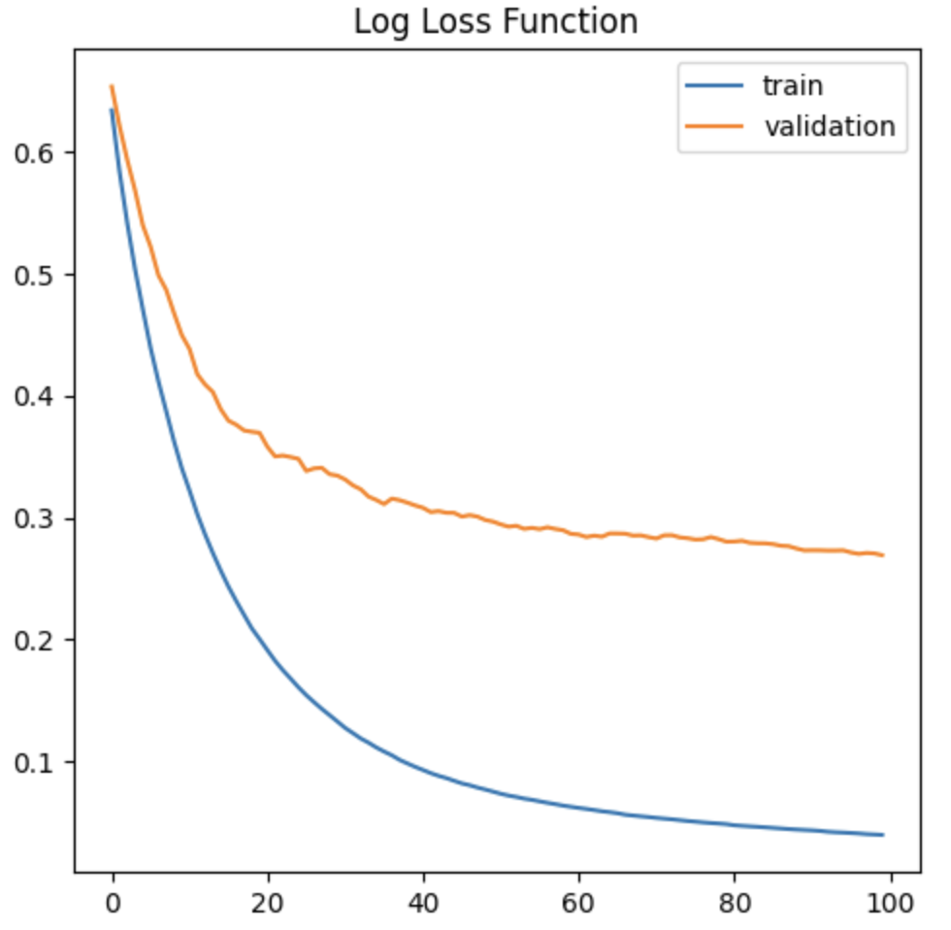
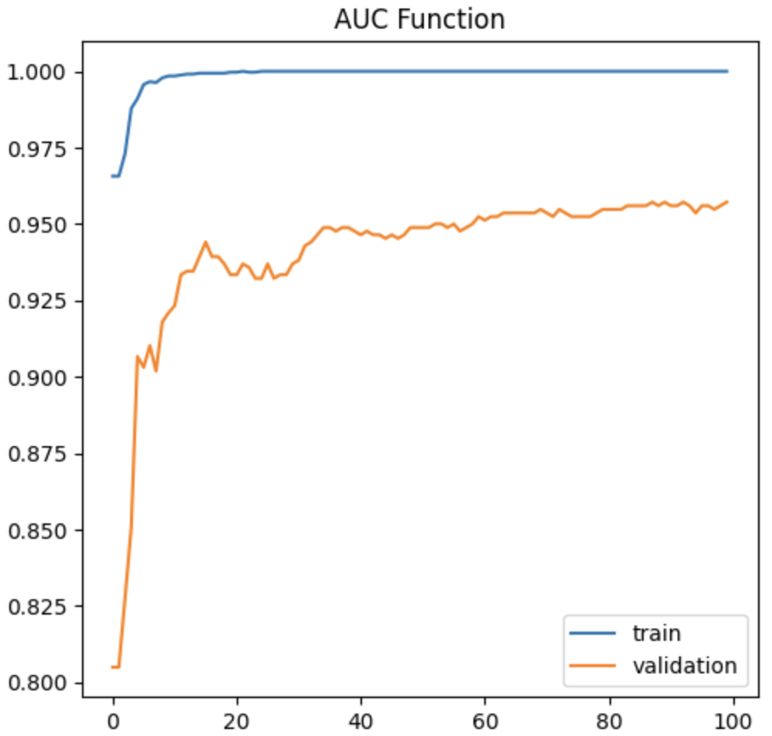
Approach
Baseline
Decision Trees
Neural Networks
More complexity
Feature Reduction
Random Forest
XGBoost
Notes:
Bryan
(15%) Approach: Describe in detail the models (baseline + improvement over baseline) that you use in your approach.
As previously mentioned from our last presentation one of the pros about utilizing xgboost is the idea that there a ton of hypertuning capabilities.
In my experience this was a huge detriment to utilizing this model as a student. Upon inspecting and causally reading many different articles. I mainly focused my efforts on three main parameters
Learning rate
Max depths
Max numbers of trees
In tuning this particular model i found that I overfit the model most of the time and this was the best result that I could find.
The package is heavily documented but with the time allotted for this class it was difficult to read through every parameter and how they improved the model which why I focused on things that were related to what we learned in class that would be applicable to the model

Slide 9
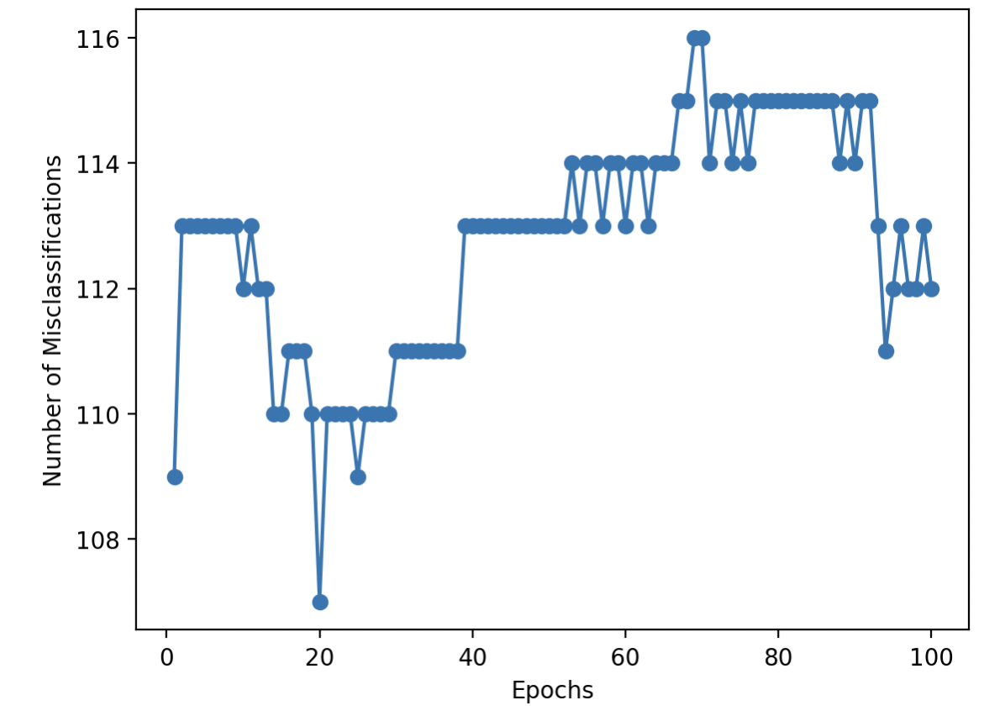
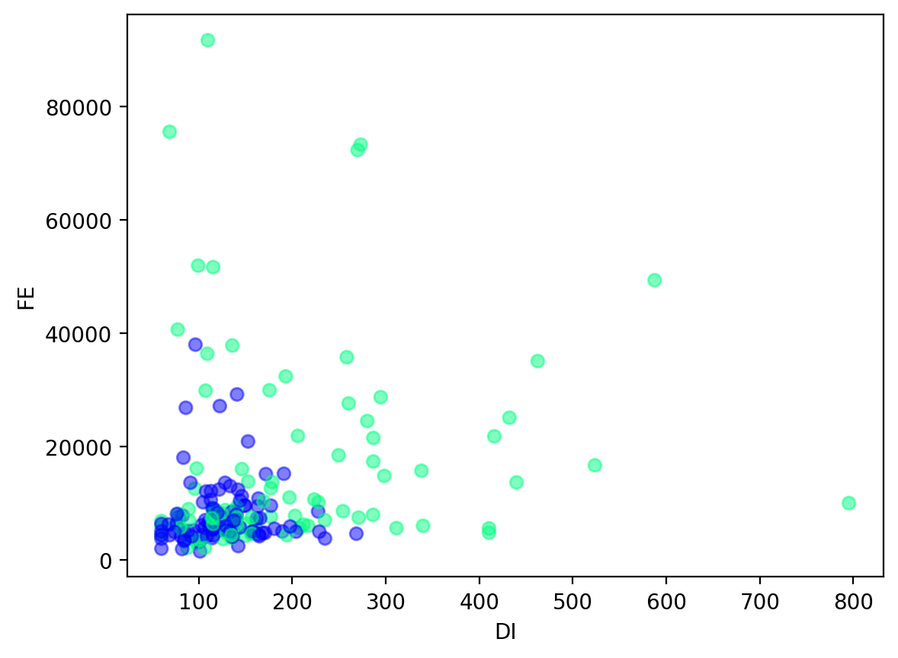
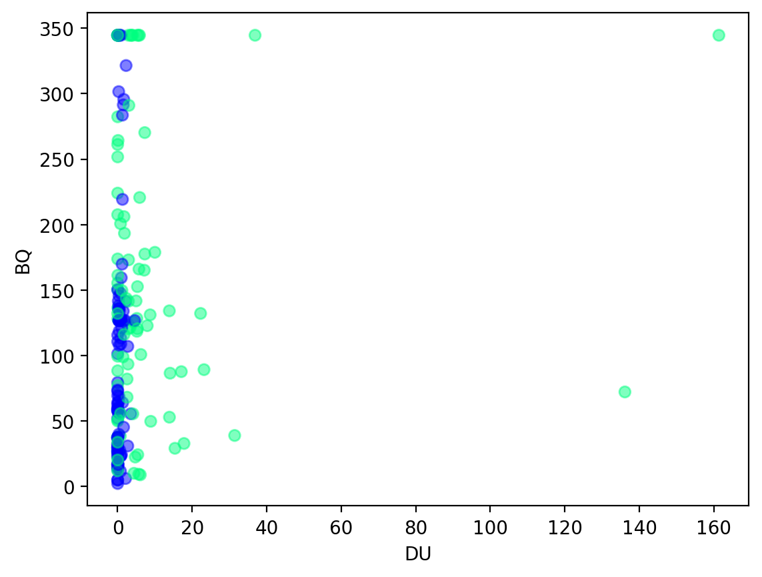
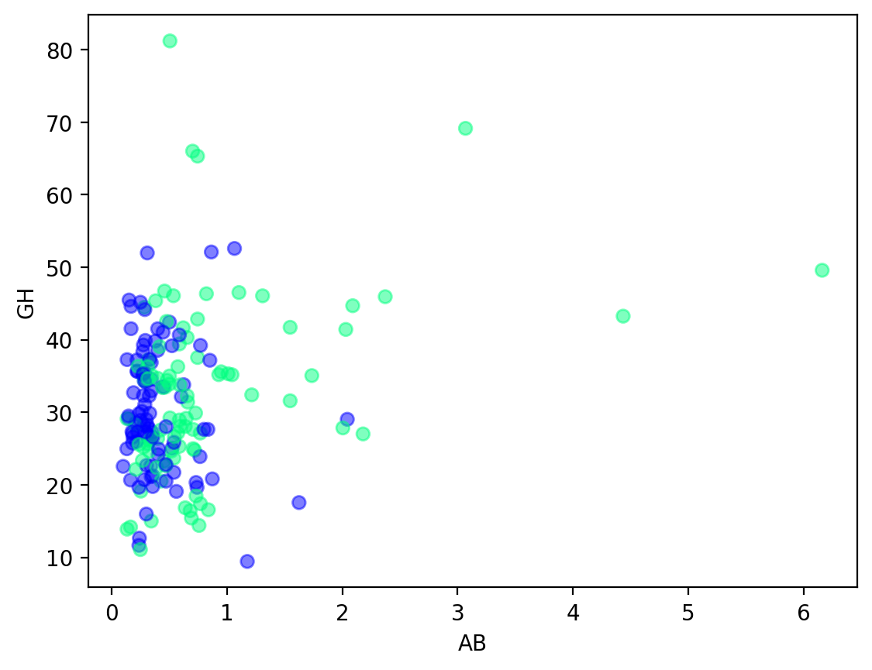
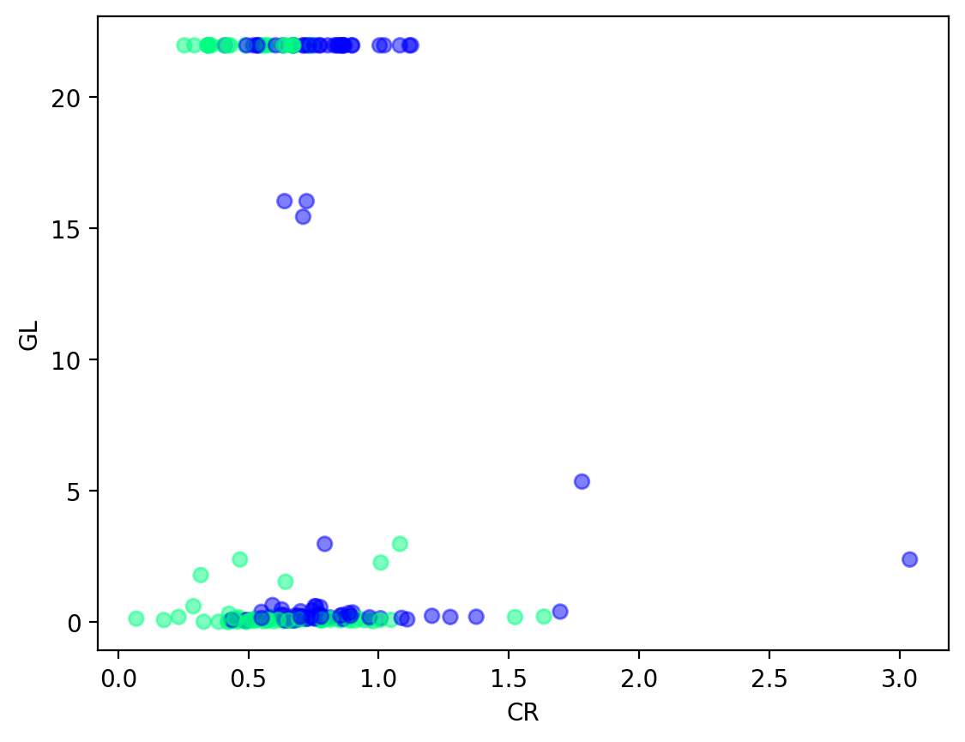
Approach
Baseline
Decision Trees
Neural Networks
More complexity
Perceptron
Logistic regression
Multilayer perceptron
No Convergence
No Linear Separability
WHY?
Notes:
Darby
(15%) Approach: Describe in detail the models (baseline + improvement over baseline) that you use in your approach.
Moving on to the neural network architecture we tried, we started with the most basic, first “neural network”, the perceptron. The perceptron is only capable of binary classification, and outputs a prediction of -1 or 1. Based on whether the output is correct, we update the weights of the model to try to converge on some minimal number of misclassifications. The traditional perceptron won’t converge if the data is not linearly separable, and as you can see we still have a massive number of errors in this model – nearly ⅔ of the 184 observations were misclassified. Why? Looking into the data (there are a number of bivariate plots on the right), it makes sense that the model didn’t converge because basically none of the parameters are linearly separable. You can see there is some more variation in the positive class (the turquoise dots) as compared to the negative class (the blue dots), but it will take more complexity to differentiate between them.

Slide 10
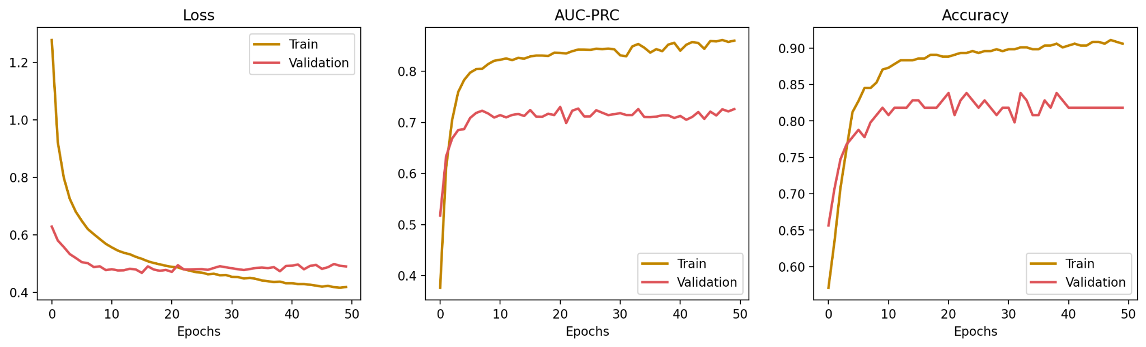
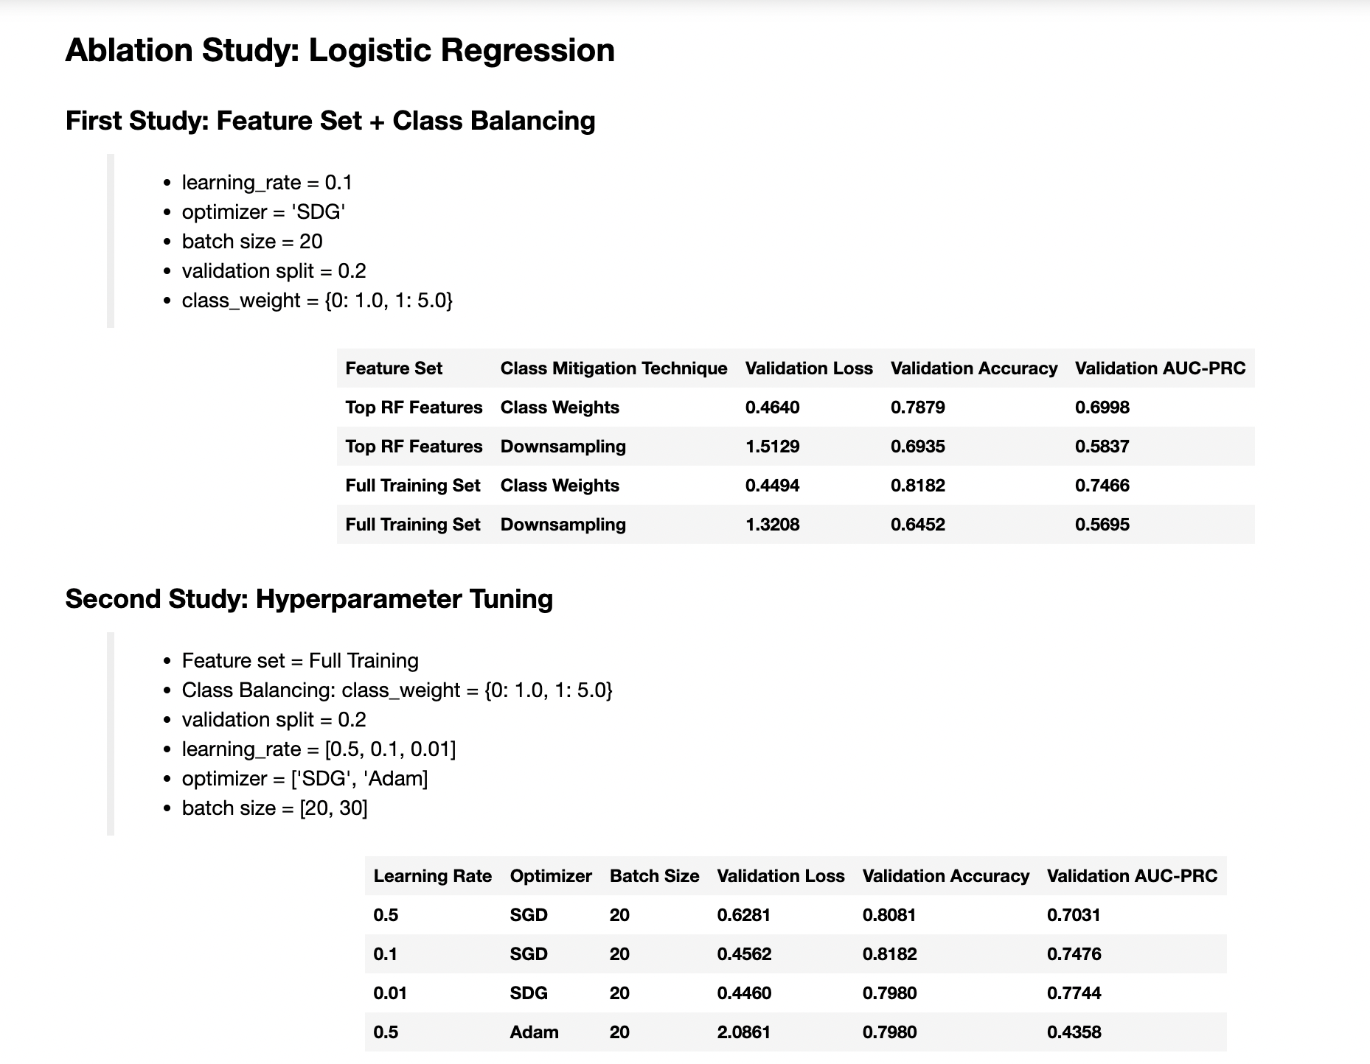
Approach
Baseline
Decision Trees
Neural Networks
More complexity
Perceptron
Logistic regression
Multilayer perceptron
val_loss = 0.4899
val_aucprc = 0.7259
Notes:
Darby
(15%) Approach: Describe in detail the models (baseline + improvement over baseline) that you use in your approach.
Since the perceptron didn’t work, our next step was to advance to logistic regression, a similar architecture but with less rigidity in the model output (using the sigmoid function we can predict probabilities of classes instead of just (-1,1). Using logistic regression, we were able to get better results. We moved forward with an ablation study to optimize the feature set, class imbalance techniques, and hyperparameter tuning. After a lot of tinkering, we weren’t able to achieve an AUC-PRC above ~0.8. Pushing to this level also seemed to cause some overfit. As planned, we moved on to a multilayer perceptron to try to push the performance further.

Slide 11
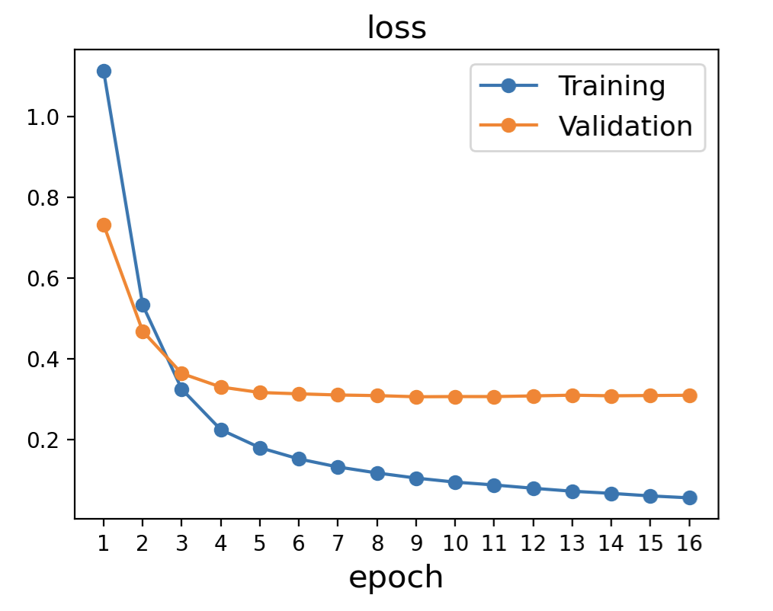
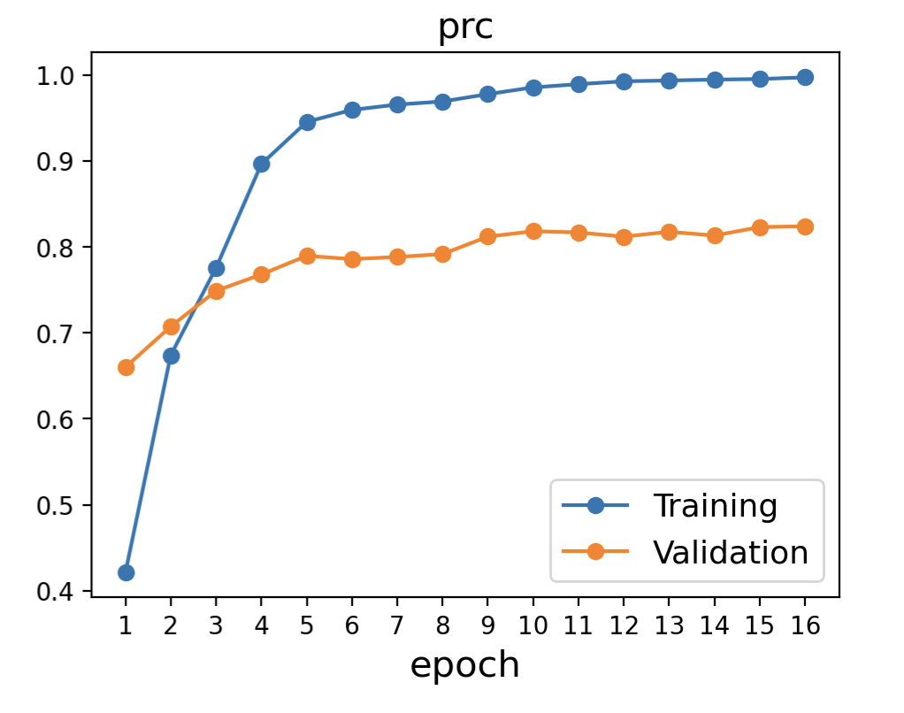
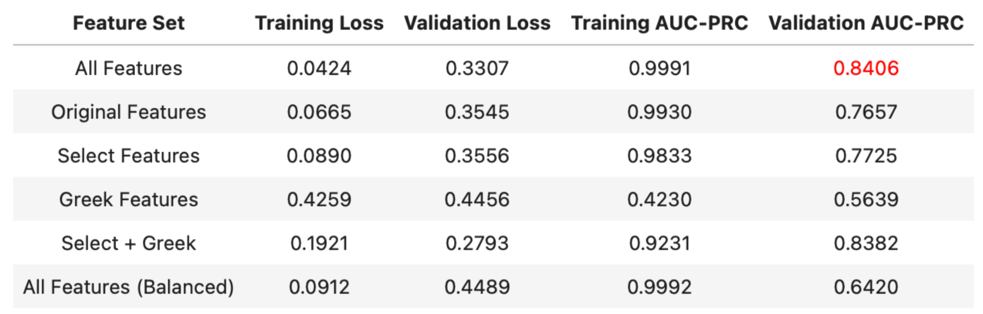
Approach
Baseline
Decision Trees
Neural Networks
More complexity
Perceptron
Logistic regression
Multilayer perceptron
Notes:
Henry
(15%) Approach: Describe in detail the models (baseline + improvement over baseline) that you use in your approach.

Slide 12
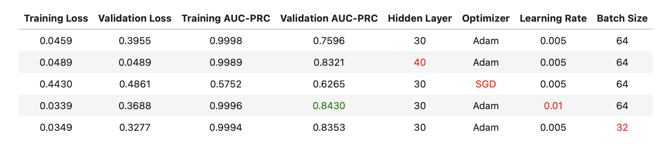
Experiments
Baseline
Decision Trees
Neural Networks
More complexity
Notes:
Darby (and maybe Henry?)
(Ablation study etc)
(30%) Experiments: Provide insight into the effect of different hyperparameter choices. Please include tables, figures, graphs to illustrate your experiments.

Slide 13
Conclusions
Best model:
Multilayer perceptron
Limitations:
Class imbalance
Possible data leakage, due to downsampling techniques
Sample sample size
Fairness:
Anonymous dataset
Men vs.women because of age-related diseases could bias results
Future:
Ensemble learning with metadata to predict classes
Notes:
Bryan
(10%) Conclusions: Summarize the key results, what has been learned, and avenues for future work.

Slide 14
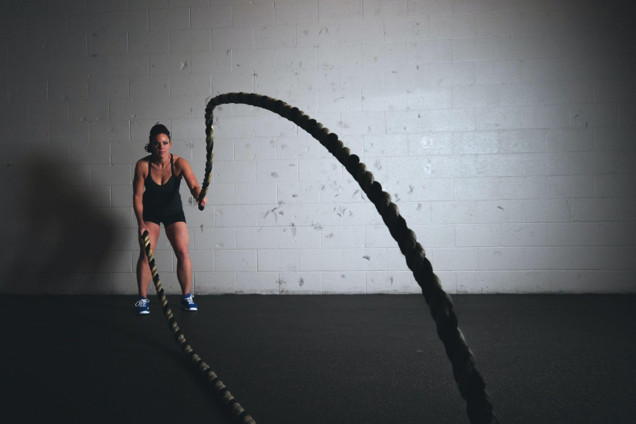
Thank you!
Questions?
Notes:
Juliana

Slide 15
Contributions
 | Preprocessing | Learning | Evaluation | Prediction | Other
Darby | EDA, downsampling, data splitting, one-hot encodings | Models trained: Logistic regression (TensorFlow), basic perceptron Ablation studies for feature selection and class imbalance techniques, hyperparameter tuning on logistic regression and multilayer perceptron Performance metrics: AUC-PRC, balanced log-loss | Logistic regression, perceptron, multilayer perceptron | Logistic regression, perceptron | Prepare slides, update repo
Bryan | EDA Sampling: 60,20,20 train/validation/test, down sampling | Model selection: XGBoost Hyperparameter optimization: Learning rate, Max depth, number of trees Performance metrics: auprc and log loss (skLearn) | XGBoost | XGBoost | Prepare slides, Update repo, Create Repo
Henry |  | Model selection: Multilayer perceptron | Multilayer perceptron | Multilayer perceptron
Juliana | EDA Feature extraction with Random Forests and PCA Dimensionality reduction: PCA Sampling: 80:20 train/test split, downsampling | Model selection: Random forest (RF) Cross-validation:K-fold cross-validation (RF) Performance metrics: auprc and balanced log loss (RF) Hyperparameter optimization: cross-validation grid search (RF) (n_estimators and max_depth) | Random forest | Random forest | Structured GitHub Repo, prepared slides, Created Readme file

Slide 16
BACKUP

Slide 17
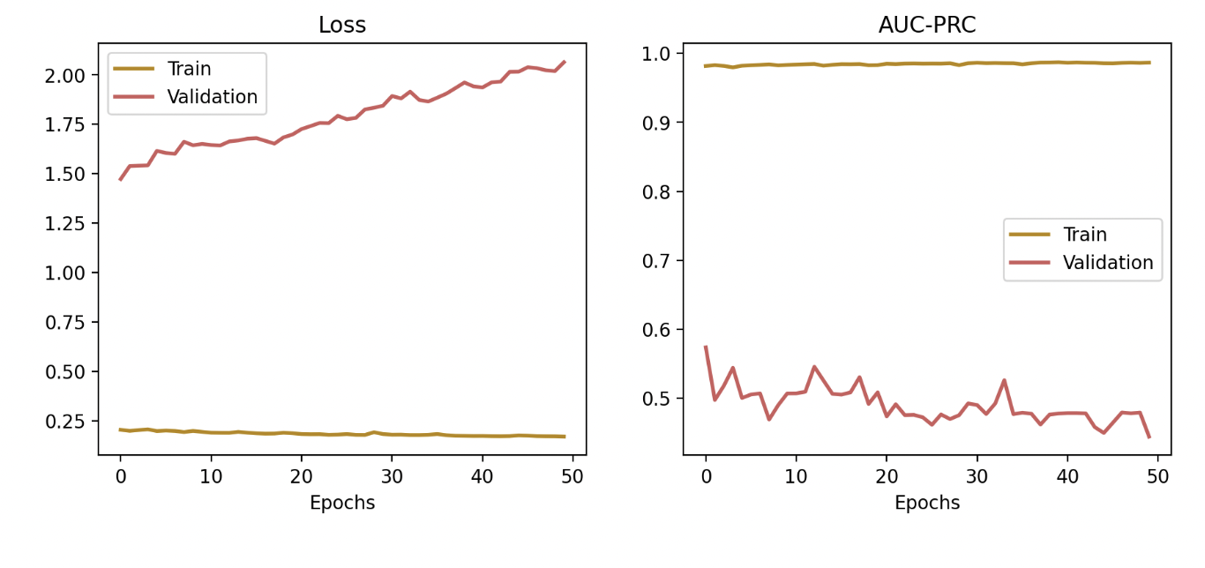
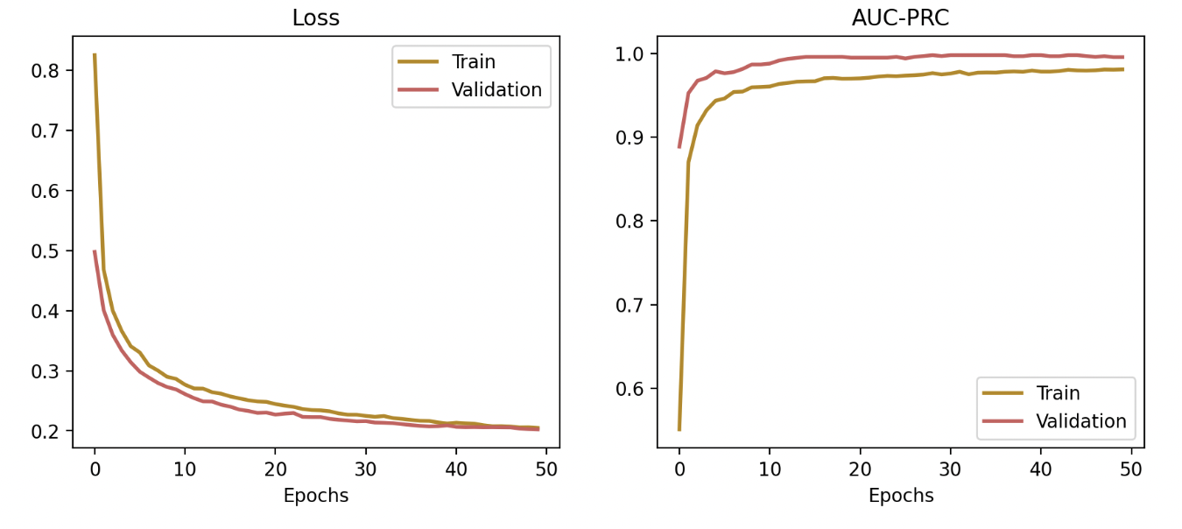
Impact of Data Leakage
Logistic Regression Proper Validation Set (not downsampled)
Logistic Regression Downsampled Validation Set: Overfit!

Slide 18
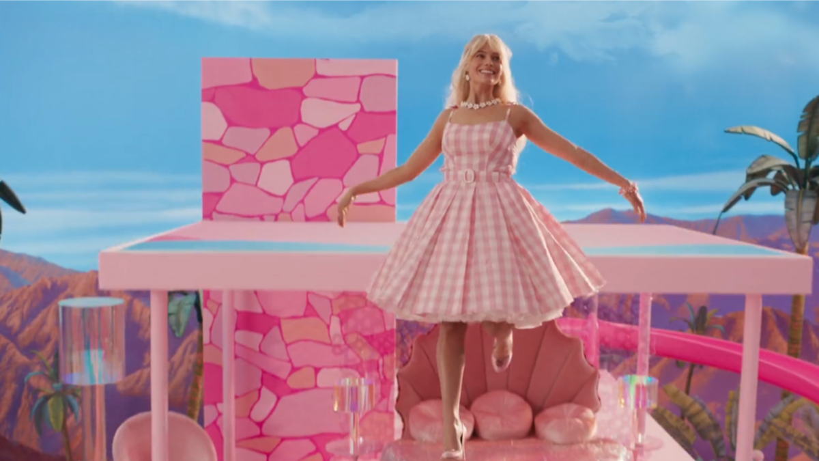

How we thought our models would perform:
How our models actually perform:

